Slide 1
Hybrid Learning to Rank for Financial Event Ranking
Advisor: Jia-Ling, Koh
Speaker: Hsiang-Hui Chou
Source: SIGIR ’21
Date:2021/1/11

Slide 2
Outline
Introduction
Method
Experiment
Conclusion

Slide 3
Problem
The prices of financial assets such as stocks and commodities are quickly moved by financial events
Essential for financial participants to quickly assess and react to financial events with potential to move the asset price
Due to the large scale of news stream, it is time and labor intensive to manually identify influential events
Notes:
Commodities商品
labor intensive勞動密集型

Slide 4
Problem

Slide 5
Target
Score financial news (document) according to its influence to the given asset (query) and rank
Notes:
制定了金融事件排名任務，旨在根據金融新聞（文檔）對給定資產（查詢）的影響進行評分

Slide 6
Input/Output
Input: candidate news D, query Q, Θ
Output: score
D : a list of word IDs that encodes the contents of the news
Q : a list of word IDs that corresponds to the name of the query asset,
e.g., “base metal”
Notes:
Θ 表示要學習的函數的參數

Slide 7
Outline
Introduction
Method
Experiment
Conclusion

Slide 8
HNR framework (Hybrid News Ranking )
Three modules:
1. Influence quantification module
2. Influence allocation module
3. Influence mixer

Slide 9
Influence Quantification Module

Slide 10
Influence Quantification Module
Deep Transformer - BERT

Slide 11
Influence Allocation Module
：the influence predictions over the query set

Slide 12
Influence Mixer
: final prediction of news $D_{t}^{i}$ over all the queries
Notes:
where yˆti ∈ R | Q | is the final prediction of news Dti over all the queries; and y ̄ti ∈ R | Q | denotes the scores from the quantification
module where we gather the output of Equation 4 across all queries.
⊙ denotes the element-wise product and power (·) is a element-wise power function. λ is a hyper-parameter to balance the contribution of the two modules.

Slide 13
CNN
stack layer
column convolution Layer
row convolution layer
FC layer.

Slide 14
Method

Slide 15
Outline
Introduction
Method
Experiment
Conclusion

Slide 16
DATASETS

Slide 17
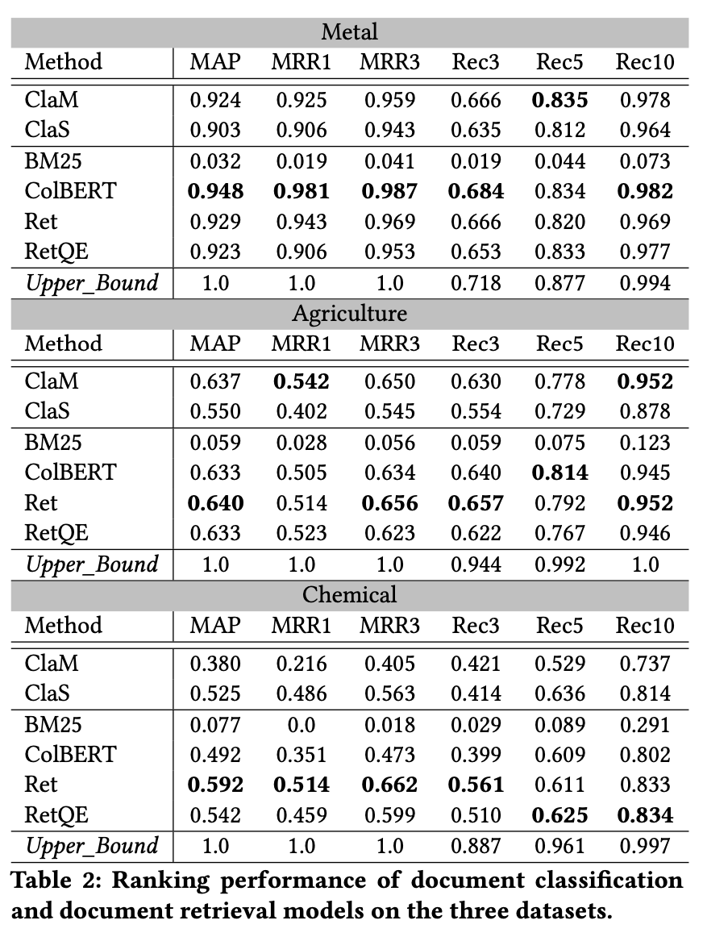
Experiment

Slide 18
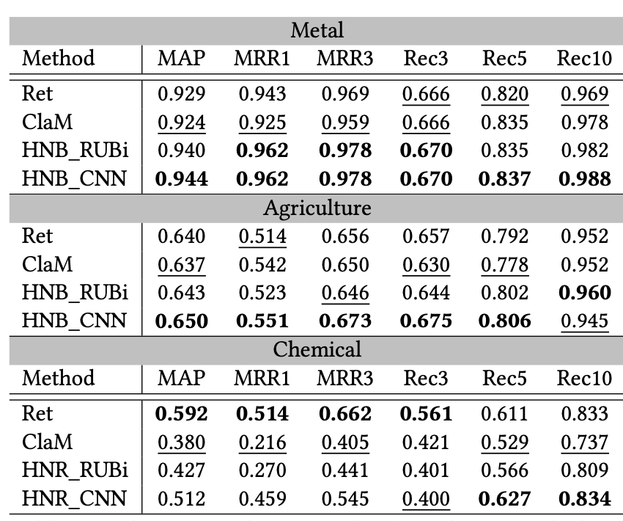
Experiment

Slide 19
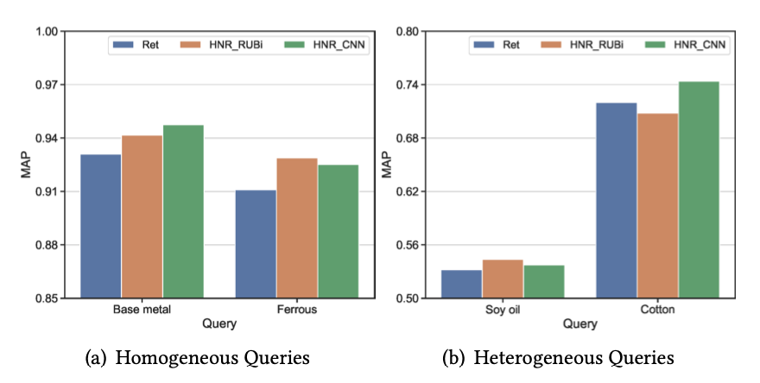
Experiment

Slide 20
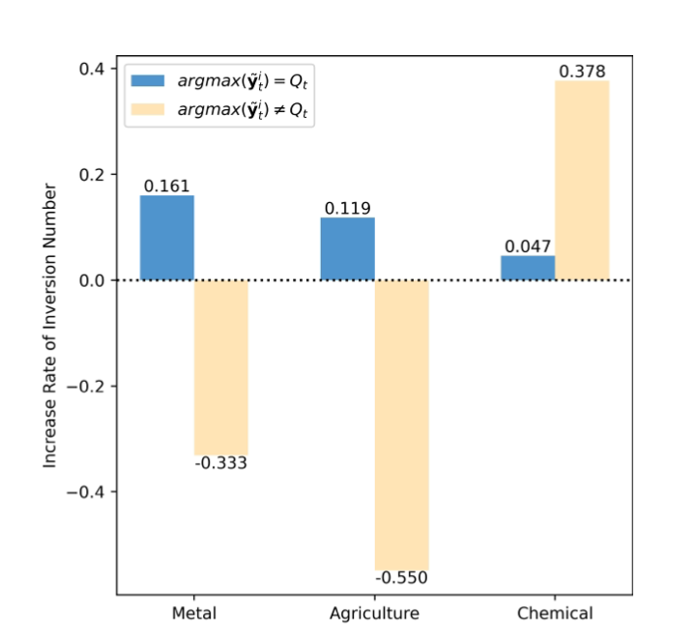
Experiment

Slide 21
Outline
Introduction
Method
Experiment
Conclusion

Slide 22
Conclusion
From the data perspective by building up a labeling system and constructed three large-scale datasets
The experimental results validate the rationality and effectiveness of solving financial event ranking through learning to rank

